Slide 1
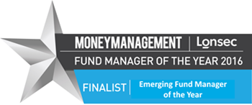
High Returns with Low Risk Are Possible in a Low Yield World
Christopher Joye, Portfolio Manager
November 2016

Slide 2
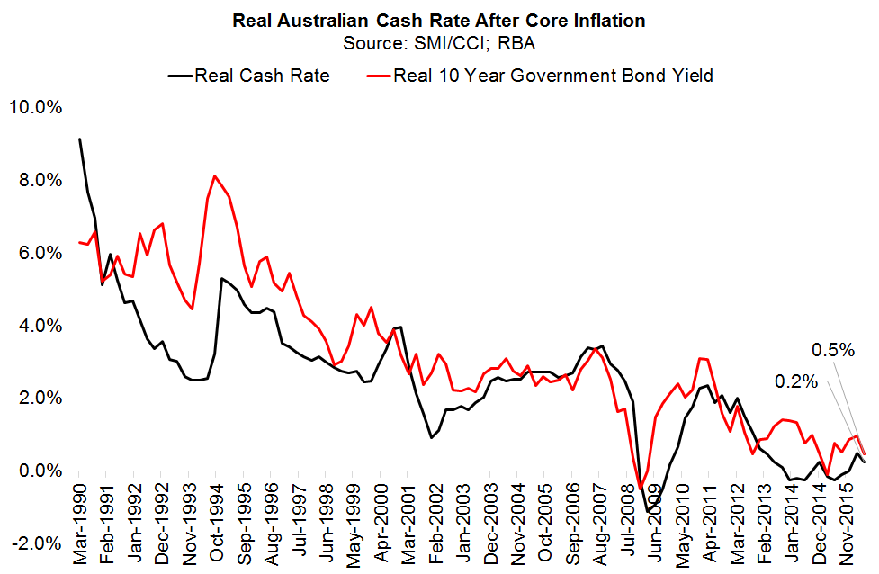
Hard Getting Safe Returns in Short/Long-Term…

Slide 3
Aussie Fixed-Income: Immensely Inefficient
Hugely opaque: no public exchange
Austraclear does not require any price reporting
In equities all prices/volumes instantly reported
Market-maker bids/offers cross all the time
Absence of bona fide “active” managers means few investors looking to identify mispricings
Paradox: the more passive (vs active) managers there are, the less price efficient asset-class becomes
Preponderance of passive investing undermines case for indexing

Slide 4
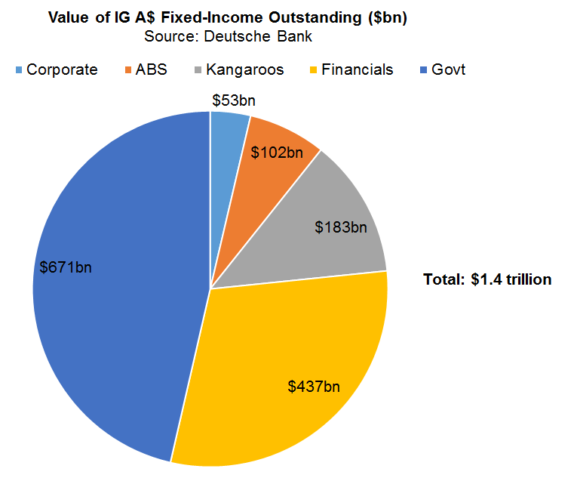
Size Similar to $1.6trn Aussie Equities Mkt

Slide 5
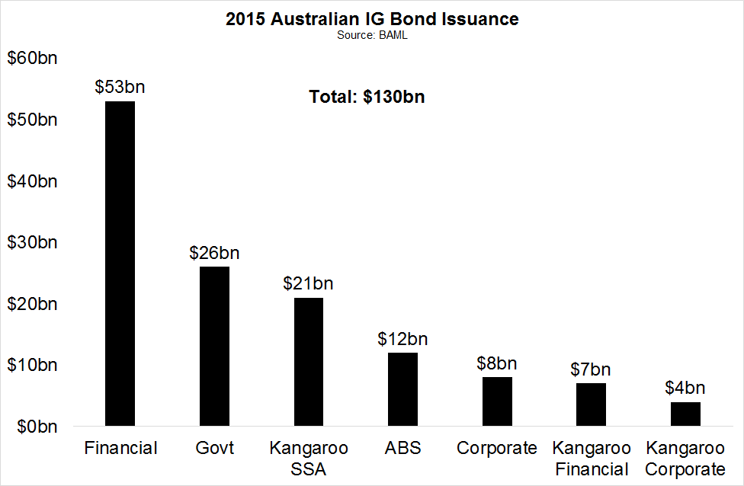
Around 10x Primary Liquidity of Aussie Equities

Slide 6
Puzzle: Inefficient Yet Everyone Underperforms
Large/inefficient asset-class…
Yet almost 90% of Aussie fixed-income funds underperformed passive Composite Bond Index after fees
But in highly efficient asset-class like Aussie equities, only two-thirds of managers underperform
Are most active Aust. fixed-income managers
Actually passive?
Systematically inferior in terms of analytical capabilities to other asset-classes?
Or both?

Slide 7
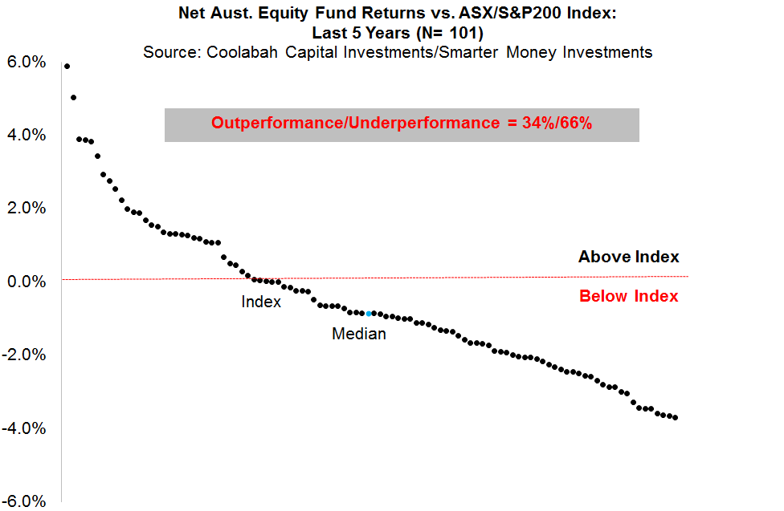
Many Aussie Equities Funds Beat Index Post Fees
34% of Aussie equity funds outperform

Slide 8
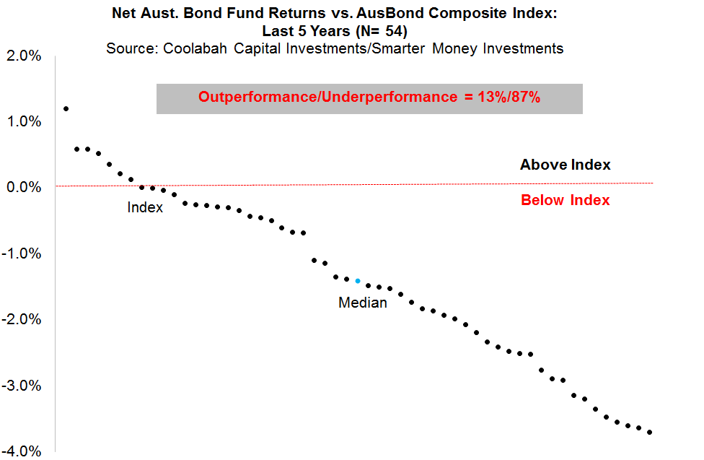
Few Fixed-Income Funds Do After Fees
Only 13% of Aussie fixed-income funds outperform

Slide 9
Alpha Generally M.I.A in Aussie Fixed-Income
“Alpha” = risk-adjusted excess returns after stripping out beta
Fixed-income managers pull 3 beta levers to boost returns
Interest rate duration beta
Credit beta
Illiquidity beta
Scant “true alpha” generation
Interest rate duration is extremely efficient market
Rates futures/FX market very transparent
Contested by every bank, hedge fund, CTA, fixed-income investor globally
Very hard to predict interest rate changes 6-12 months ahead, let alone 4-5yrs out (Composite Index duration)

Slide 10
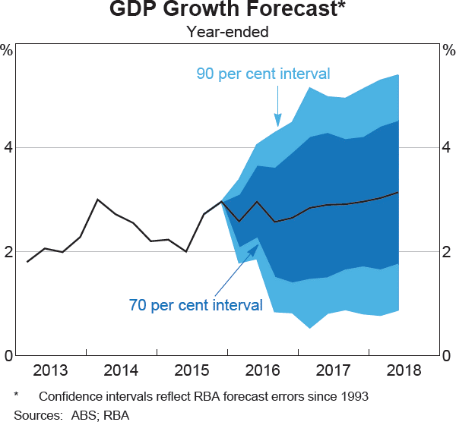
RBA 90% Sure GDP b/w 1% and 4.75% in 2017!

Slide 11
Beta Parading As Alpha
Domestic fixed-income mgers mostly “hold-to-maturity”—no trading alpha
Managers assume they’re getting repaid at maturity with negligible credit risk
Main source of return is yield; not changing capital values
Little-to-no secondary trading
Explains striking paucity of analysts per manager compared to equities
Illiquidity beta through direct loans is not alpha
Lack of sub-IG liquidity/secondary market means producing alpha is very difficult
Cannot exit positions once they hit fair value

Slide 12
Capturing Latent Alpha Requires Valuation Skill
Requires quant. asset valuation capabilities
Top-down econometric models identifying anomalies in current market pricing
Controlling for maturity, credit rating, capital structure position, liquidity, industry sector, etc
Bottom-up Merton-style models that price fair-value credit spreads based on issuer’s assets, liabilities, leverage, equity volatility and bond’s maturity & capital structure position
Project probabilities of default and loss (subject to capital structure position)
Combined with secondary trading capability can easily produce high absolute returns in low yield world

Slide 13
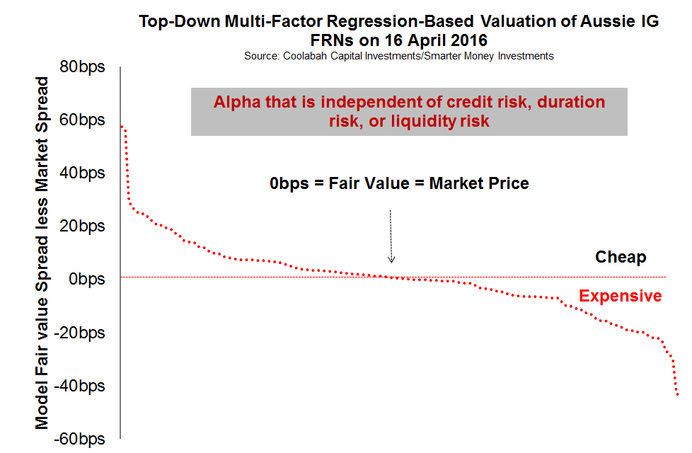
Market Mispricing Aussie Spreads by +/-40bps

Slide 14
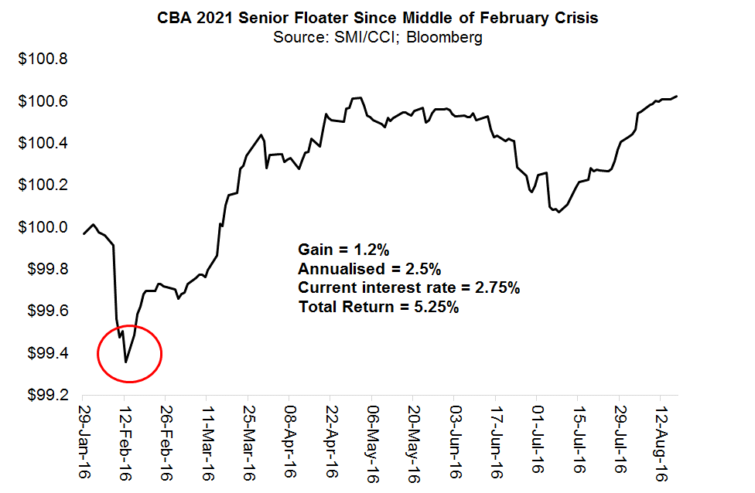
CBA Snr Floater: 5.25% Annualised Total Return

Slide 15
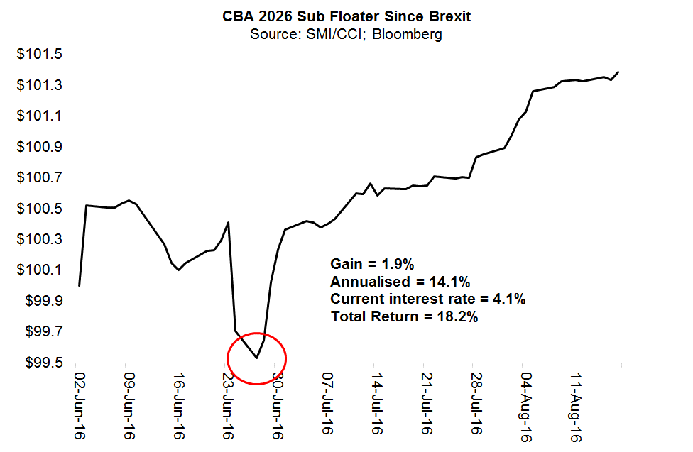
CBA Sub Floater: 18.2% Annualised Total Return

Slide 16
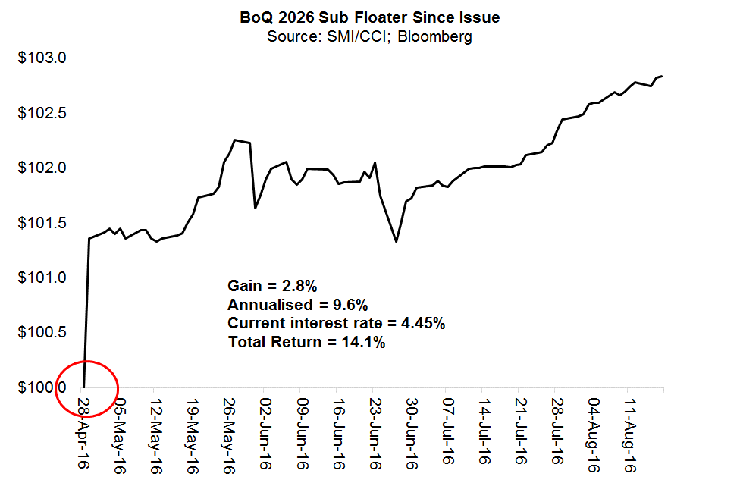
BoQ Sub Floater: 14.1% Annualised Total Return

Slide 17
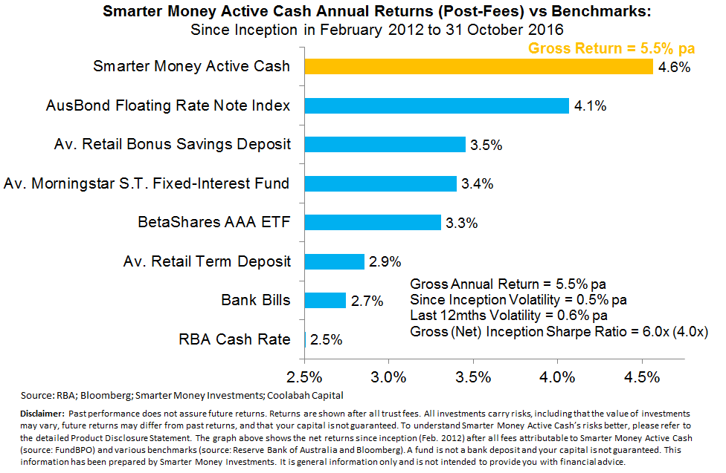
Smarter Money Active Cash

Slide 18
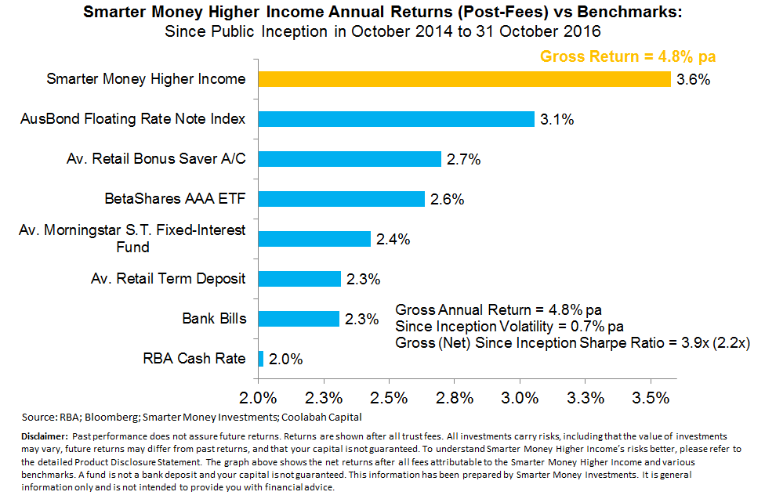
Smarter Money Higher Income

Slide 19
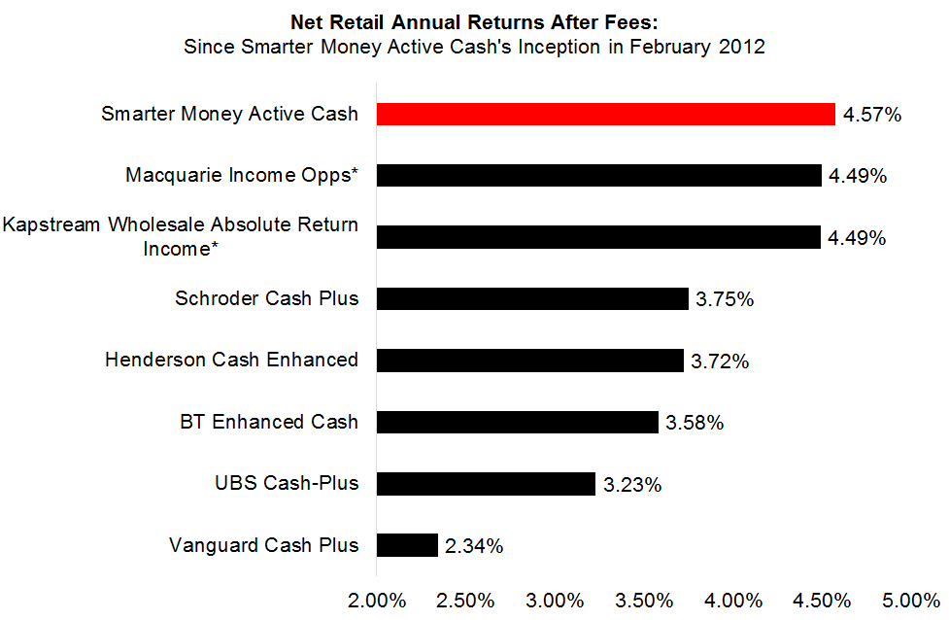
Compared to Peers Since Inception

Slide 20
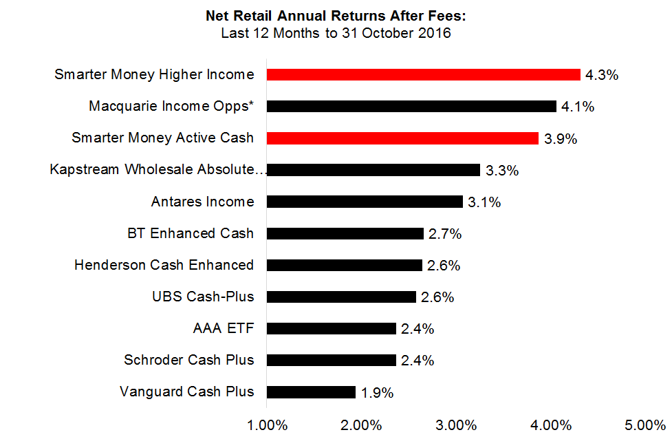
Compared to Peers Last 12 Months

Slide 21
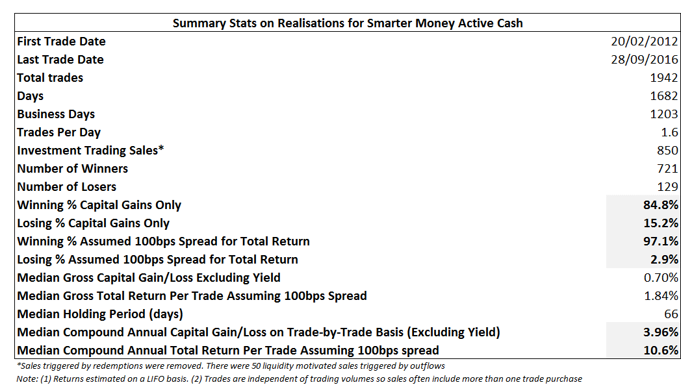
SMAC: 85%-97% Win Ratio

Slide 22
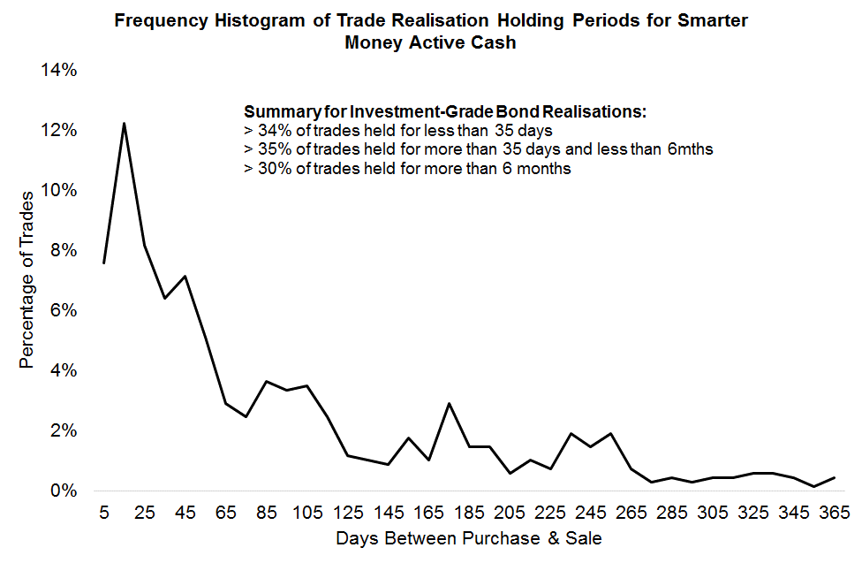
SMAC Trade-by-Trade Performance

Slide 23
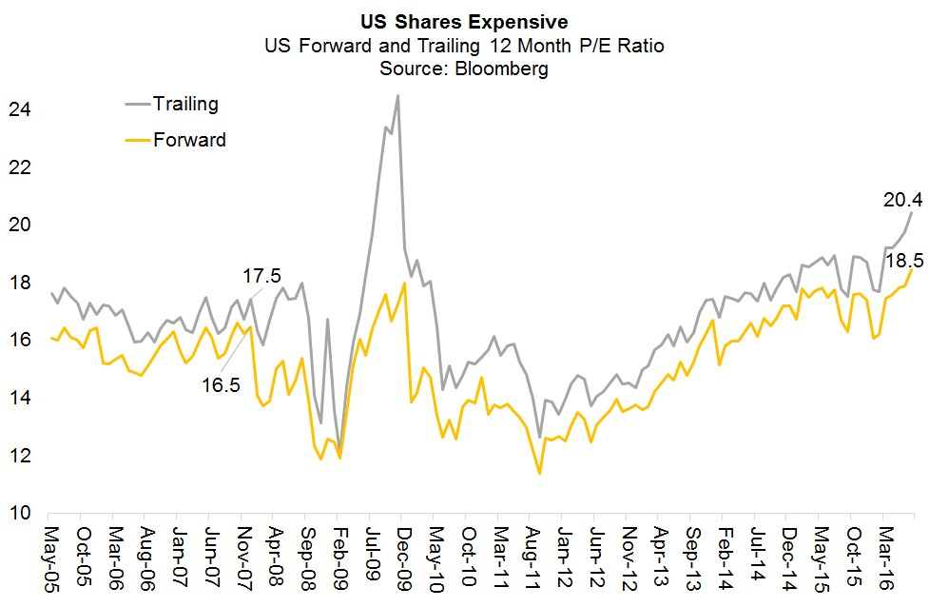
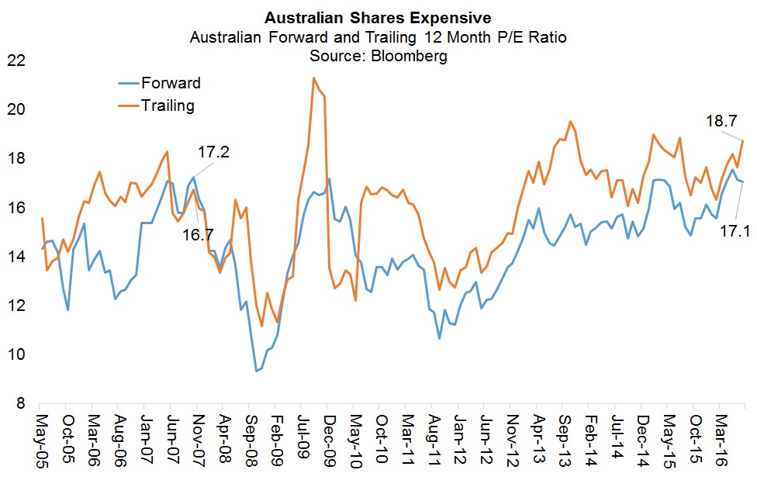
Equities Expensive

Slide 24
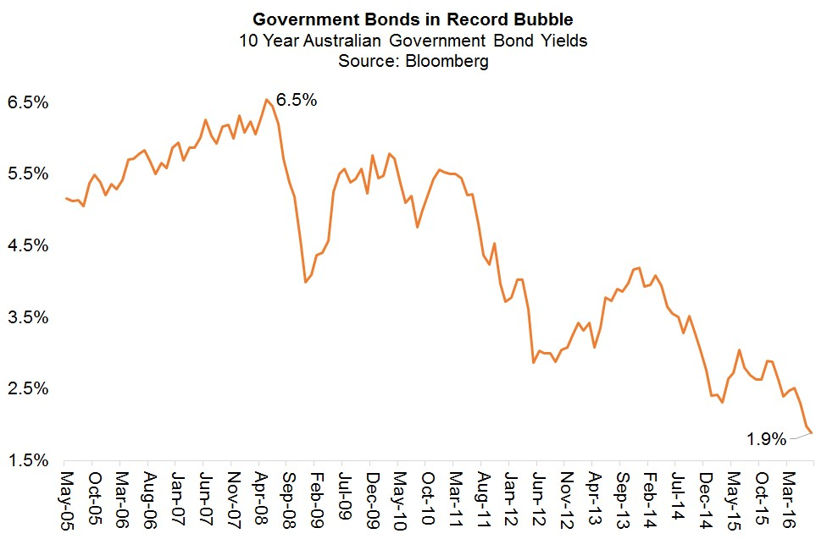
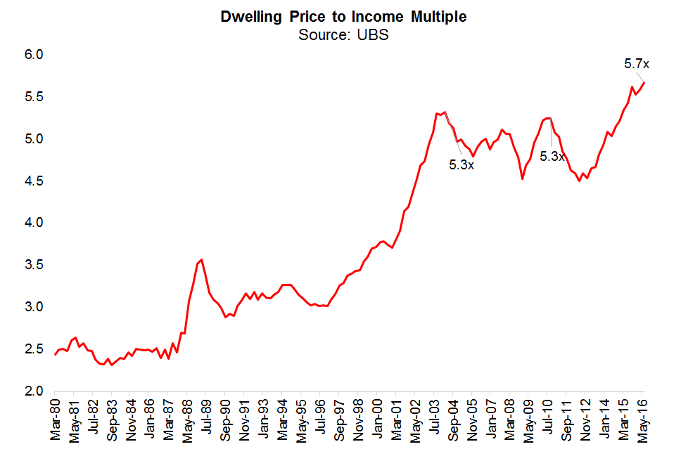
Bonds and Residential Property Uber Expensive

Slide 25
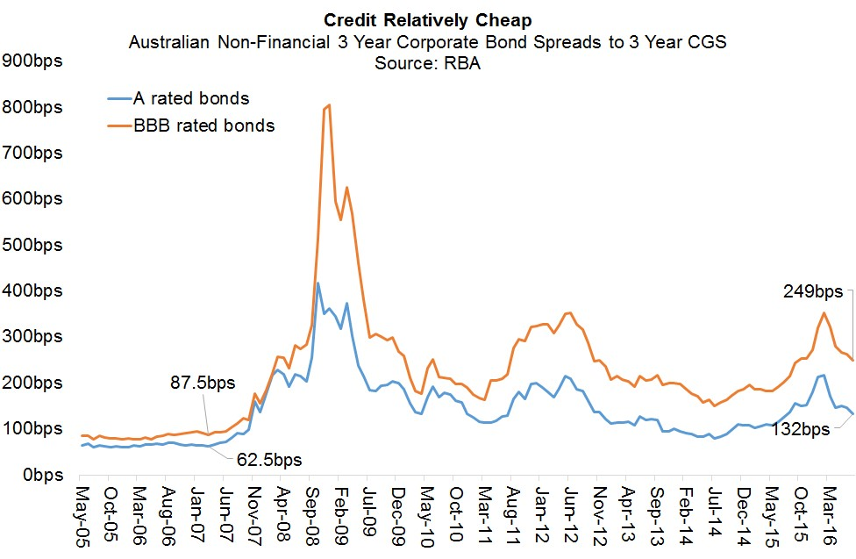
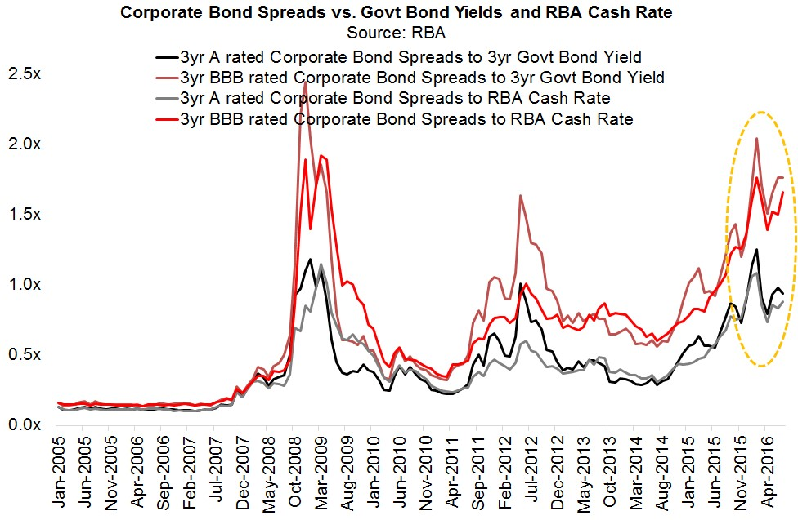
Aussie Investment-Grade Credit Still Attractive

Slide 26
But What About Secondary Liquidity?
$1.4 trillion IG fixed-income in Australia
$350 billion IG credit
RBA in 2015 finds a 50% secondary turnover ratio pa
Assume 40%
$140bn pa in secondary turnover/$2.7bn per week
Near infinite liquidity in RBA repo-eligible assets: govt bonds, senior ADI bonds, AAA rated RMBS/ABS
Notoriously one-sided market
If you buy during shocks when everyone is a seller
And you sell during booms when everyone is a buyer
Practical liquidity much greater

Slide 27
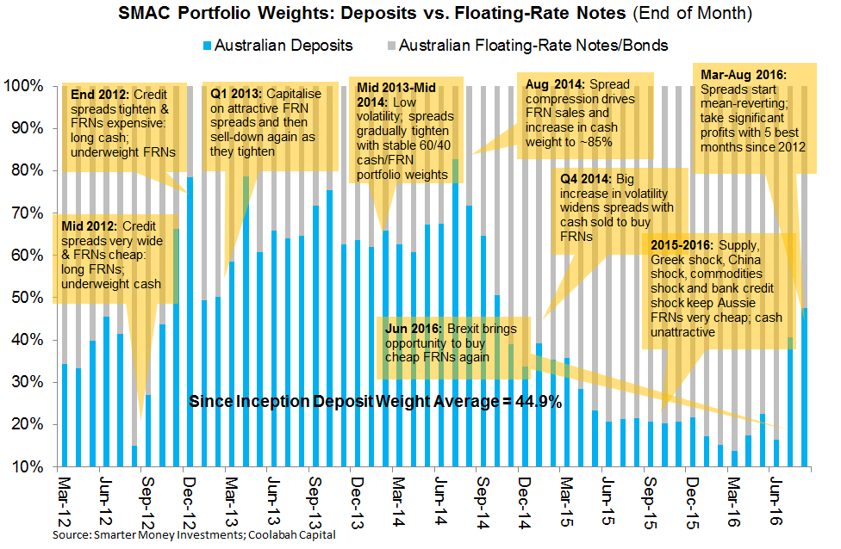
Buy (Sell) When Market Sells (Buys)

Slide 28
Key Take-Aways
Short-term: cash and fixed-income yields non-viable investments
Long-term: maybe rates normalize
In interim, you can still capture high returns from very liquid, low risk assets without taking on duration in low yield world
Requires active exploitation of regular mispricings of investment-grade, floating-rate Australian credit
Turn a senior FRN paying 2.75% into a 5.25% total return
Alongside (very low) volatility, Aussie credit also one of the cheapest asset-classes today with spreads much wider than 2007 levels
Problem is vast bulk of fixed-income solutions are beta pretending to be alpha

Slide 29
Important Information
The information in this presentation has been prepared by Smarter Money Investments Pty Ltd. It is general information only and is not intended to provide you with financial advice. You should not rely on any information herein in making any investment decisions. To the extent permitted by law, no liability is accepted for any loss or damage as a result of any reliance on this information. The Product Disclosure Statement (PDS) for the Smarter Money Fund should be considered before deciding whether to acquire or hold units in it. The PDS can be obtained by visiting www.smitrust.com.au. None of Select Asset Management Limited, SMI, Yellow Brick Road Holdings Limited, Coolabah Capital Pty Ltd, BBB Capital Pty Ltd or Winston Capital Pty Ltd (the Promoters) nor any of their respective shareholders, directors and associated businesses assume any liability to investors in connection with any investment in the fund, or guarantees the performance of any obligations to investors, the performance of the Smarter Money Fund or any particular rate of return. The repayment of capital is not guaranteed. Investments in the fund are not deposits or liabilities of any of the abovementioned parties, nor of any Authorised Deposit-taking Institution. The fund is subject to investment risks, which could include delays in repayment and/or loss of income and capital invested. Past performance is not an indicator of nor assures any future returns or risks.
Notes:
29

